Slide 1
2CEIT403:
APPLICATION DEVELOPMENT TOOLS
Bhavisha R. Suthar

Slide 2
SYLLABUS
Click here

Slide 3
UNIT-I Introduction to .NET Technology

Slide 4
What is .NET ?
Microsoft.NET is a Framework
Microsoft .NET is a Framework which provides a common platform to Execute or, Run the applications developed in various programming languages.
Microsoft announced the .NET initiative in July 2000.
The main intention was to bridge the gap in interoperability between services of various programming languages.

Slide 5
.NET Objectives
The .NET Framework is designed to fulfill the following objectives:
Provide object-oriented programming environment
Provide environment for developing various types of applications, such as Windows-based applications and Web-based applications
Code Reusability
Platform Independence
Supports multiple languages
Notes:
Faculty Notes:

Slide 6
Languages used to develop .Net Application
Visual C#
VB.Net
VC++.Net
F#
JavaScript
Java
HTML
Python
Ruby
PowerShell
SQL
JSON
XML
PHP
Go
R
Perl

Slide 7
Languages
C# is a simple, modern, object-oriented and type-safe programming language.
F# is a cross-platform, open-source, functional programming language for .NET. It also includes object-oriented and imperative programming. used more for analysis, modeling, calculation type work and less for e.g. integration and UI
Visual Basic is an approachable language with a simple syntax for building type-safe, object-oriented apps.

Slide 8
Types of Applications
Console Applications
Windows Services
Client/ Desktop Applications
Win Forms
WPF
Server/ Web Applications
ASP.NET Web Forms
ASP.NET is an open source web framework, created by Microsoft, for building modern web apps and services using HTML, CSS and JAVASCRIPT that run on macOS, Linux, Windows etc…
ASP.NET MVC
XML Web Services
XML Web services provide a way to describe their interfaces in enough detail to allow a user to build a client application to talk to them. This description is usually provided in an XML document called a Web Services Description Language (WSDL) document.
WCF Services
Win Store Apps
Smart Device Applications

Slide 9
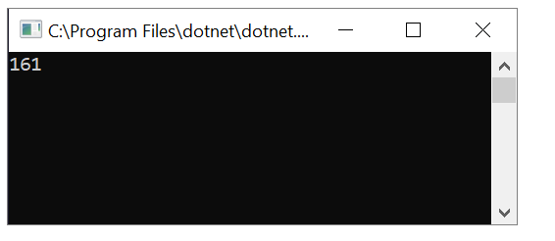
Console application
A console application, is an application that takes input and displays output at a command line console with access to three basic data streams: standard input, standard output and standard error.

Slide 10
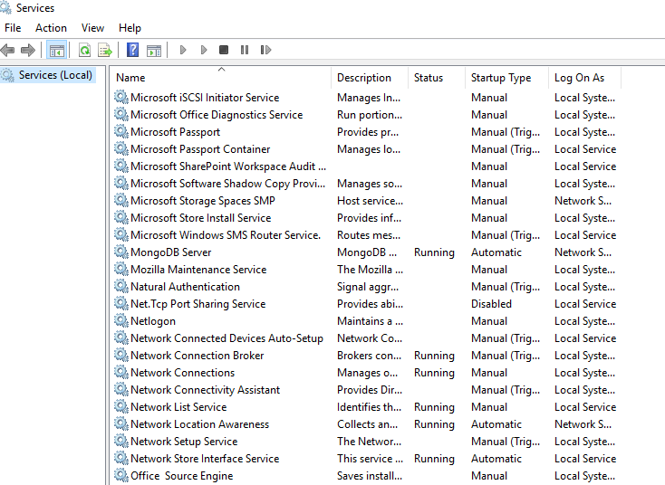
Windows Services
WS don’t have their own user interface , they start after os started and continue run in in background. Example: SQL SERVER,IIS SERVER.(SERVER KIND OF APPLICATIONS)

Slide 11
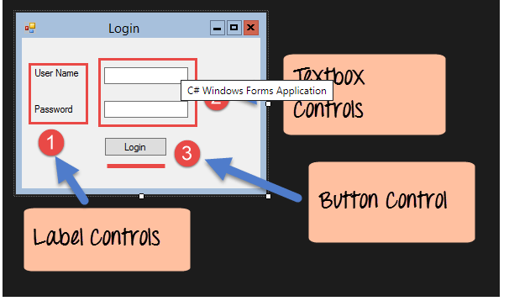
Windows Form Based Application

Slide 12
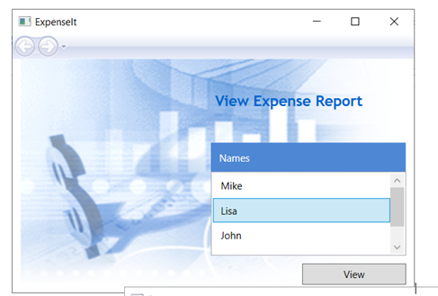
Windows Presentation Foundation
supports 3D graphics, Data binding ,very interactive ,highly animated ,with lots of color compare to Windows-based applications.

Slide 13
Cont…
ASP.Net MVC (Model View Controller) :
MVC patterns separate input, processing and output of an application
Model is responsible for maintaining application data and business logic.
View is a user interface of the application, which displays the data.
Controller: it is really the heart of the MVC, the intermediary that ties the Model and the View together, it takes user input, manipulates the model & causes the view to update
WCF: Windows Communication Foundation
It is unified framework for creating secure, reliable, transacted, and interoperable distributed applications.
It is a framework for building service-oriented applications.
Notes:
Controller handles user's requests and renders appropriate View with Model data.

Slide 14
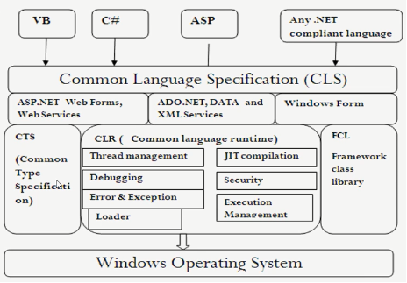
.NET Framework
(Common Type System)
Notes:
Faculty Notes:
Figure above illustrates the Microsoft .NET Framework. All .NET languages are built on a Common Language Specification. While designed specifically to support the .NET versions of Visual Basic, C++, C# and JScript, .NET also supports other languages that can be modified to this specification. These include Perl, Python, COBOL, Eiffel, Pascal, Fortran, SmallTalk, Java, RPG, Ada, APL, J# and others.
The .NET Framework is designed to unify programming models to enable cross-language integration.
The Microsoft Active Server Page (ASP) technology has been enhanced as ASP.NET and is designed to allow the easy development of Web services and Web forms see figure above. The development of Windows forms has also been improved with .NET, and ADO.NET provides full support for data and XML. Visual Studio 2005 supports and integrates all of these development environments, automating many development tasks that previously required manual integration.
Each of the languages in the figure is supported by Visual Studio 2005, which is an enhanced IDE. The other languages discussed earlier can also be added to Visual Studio 2005. The strategy behind Visual Studio 2005 is to enable applications to be developed within Windows for later execution in a .NET environment on any platform.

Slide 15
Components of .NET Framework
Common Language Runtime (CLR)
.Net Framework Class Library (FCL)
Common Type System (CTS)
Common Language Specification (CLS)

Slide 16
1. Common Language Runtime (CLR)
It is a run-time environment which executes the code written in any .NET programming language.
.Net framework provides the support for many languages like C#, F#, C++, Cobra, Jscript.Net, VB.Net, Oxygene etc
The code which runs under the CLR is called as Managed Code.
Functions of the CLR:
It converts program into native code.
Handles Exceptions, Thread execution, Provides type safety
Memory management
Provides security: it control the permissions that an individual
Improve performance
Language independent, Platform independent
Garbage collection

Slide 17
Garbage collector (GC)
The garbage collector (GC) manages the allocation and release of memory. The garbage collector serves as an automatic memory manager.
Garbage Collection in C# has the following advantages:
You don’t need to free memory manually while developing your application.
It also allocates objects on the managed heap efficiently.
When objects are no longer used then it will reclaim those objects by clearing their memory, and keeps the memory available for future allocations.
Managed objects automatically get clean content to start with, so their constructors do not have to initialize every data field.

Slide 18
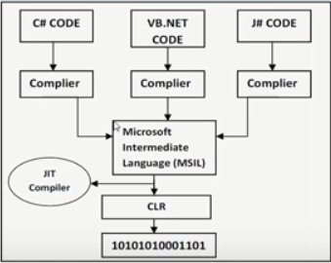
Execution in CLR
Microsoft Intermediate Language (MSIL):
Known as intermediate Language (IL) or Common Intermediate Language (CIL).
During compile time, the compiler convert the source code into MSIL.
MSIL is CPU/Language independent set of instructions.
It includes instructions for loading, storing, initializing & calling methods on objects, as well as instructions for arithmetic and logical operations, control flow, direct memory access, exception handling, and other operations.
Generates the required metadata.

Slide 19
Execution in CLR
Just In Time (JIT) Compiler:
At execution time, a just-in-time (JIT) compiler translates the MSIL into native code.
Native code refers to programming code that is configured to run on a specific processor.
JIT Types:
Pre-JIT Compiler: Compiles entire code into native code completely
Econo JIT Compiler: Complies only those methods that are called at runtime and removes them from memory after execution.
Normal JIT Compiler: Compiles only that part of code when called and places in cache
During this compilation, code must pass a verification process that examines the MSIL and metadata to find out whether the code can be determined to be type safe.
Notes:
Type safe: One class object can not be assigned two second class object.

Slide 20
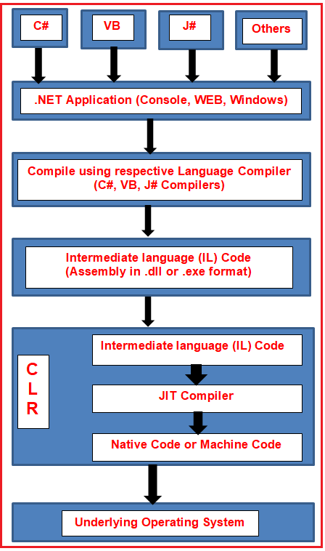
Execution Process

Slide 21
IL=MSIL=CIL
Microsoft Intermediate Language (MSIL) is a language used as the output of a number of compilers (C#, VB, .NET, and so forth).
Microsoft Intermediate Language (MSIL) is a CPU-independent set of instructions that can be efficiently converted to the native code.
We can also call it as Intermediate Language (IL)/ Common Intermediate Language (CIL)/Microsoft Intermediate language
.

Slide 22
MSIL = CIL = IL(Cont..)
The MSIL code includes instruction to load, initialize and invoke methods on objects.
It also includes the instructions for various operations on program code, such as arithmetic and logical operations, control flow, memory access, exception handling etc.
The program’s source code is converted to MSIL code, which is equivalent to JAVA Byte Code.
MSIL code is executed by the JIT Compiler to generate native code.
The native code is executed by the computer’s processor.

Slide 23
2. .NET Framework Class Library
.NET Framework Class Library is the collection of classes, namespaces, interfaces and value types that are used for .NET applications.
It contains thousands of classes that supports the following functions.
Base and user-defined data types
Support for exceptions handling
input/output and stream operations
Communications with the underlying system
Access to data
Ability to create Windows-based GUI applications
Ability to create web-client and server applications
Support for creating web services

Slide 24
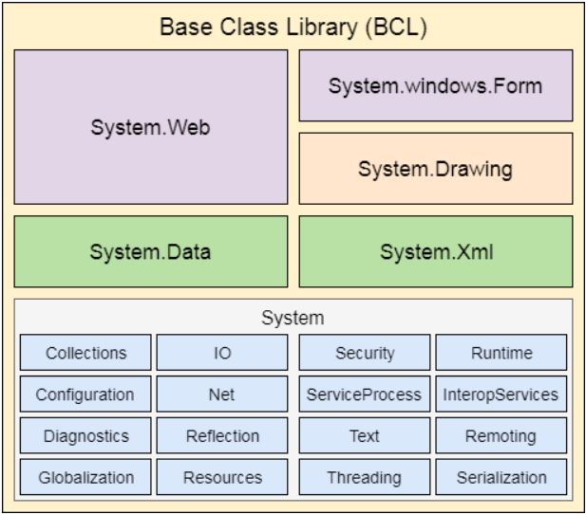
.NET Framework Class Library
.NET Framework Base Class Library:
.NET Base Class Library is the sub part of the Framework that provides library support to Common Language Runtime to work properly.
It includes the System namespace and core types of the .NET framework.

Slide 25
.NET Framework Class Library
Namespace
A namespace is a logical collection of classes with a unique name.
Example System

Slide 26
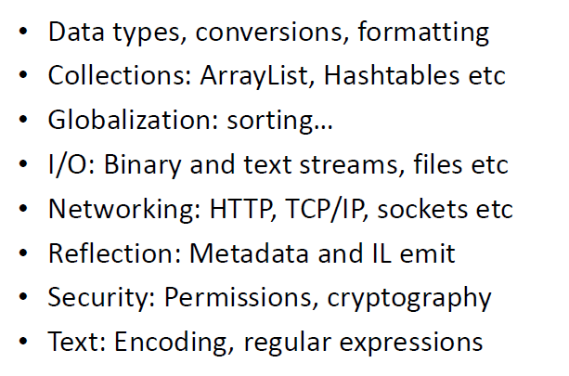
Base Class Library

Slide 27
3. Common Type System
The Common Type System (CTS) is a catalog of .NET types: System.Int32, System.Decimal, System.Boolean and so on.
Developers are not required to use these types directly.
These types are the underlying objects of the specific data types provided in each managed language.
The following is the code for declaring an integer in C# and Visual Basic .NET. Either syntax maps to a System.Int32 object.
e.g. int nVar=0; // C# integer
dim nVar as integer=0 // VB .NET integer
CLS works with CTS to ensure language interoperability
CTS defines some basic data types and every language that is designed for use with .NET framework should be able to match its data types to these defined basic data types. So when various languages are designed following CTS, they will be able to communicate with each other and this is nothing but cross-language interoperability or communication.

Slide 28
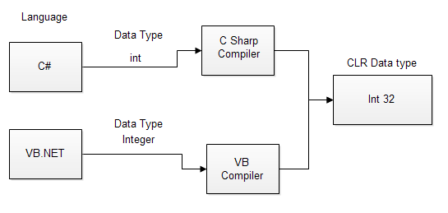
Common Type System
For example, when we declare an int type data type in C# and VB.Net then after compilation they are converted to int32. In other words, now both will have a common data type Int32.

Slide 29
4. Common Language Specification
CTS is a sub set of CLS.
It specifies a set of rules that needs to be satisfied by all language compilers targeting CLR.
It helps in cross language inheritance and cross language debugging.
Provides guidelines that language to follow so that it can communicate with other .NET languages in a seamless manner.
Example: Take C-Sharp and VB.net, In C# each and every statement must have to end with a semicolon it is also called a statement Terminator but in VB.NET each and every statement should not end with a semicolon(;).
Case sensitive, Multiple Inheritance

Slide 30
Common Language Specification
Example:one rule is that you cannot use multiple inheritance within .NET Framework. As you know C++ supports multiple inheritance but; when you will try to use that C++ code within C#, it is not possible because C# doesn’t supports multiple inheritance.
Example :You cannot have members with same name with case difference only i.e. you cannot have add() and Add() methods. This easily works in C# because it is case-sensitive but when you will try to use that C# code in VB.NET, it is not possible because VB.NET is not case-sensitive.

Slide 31
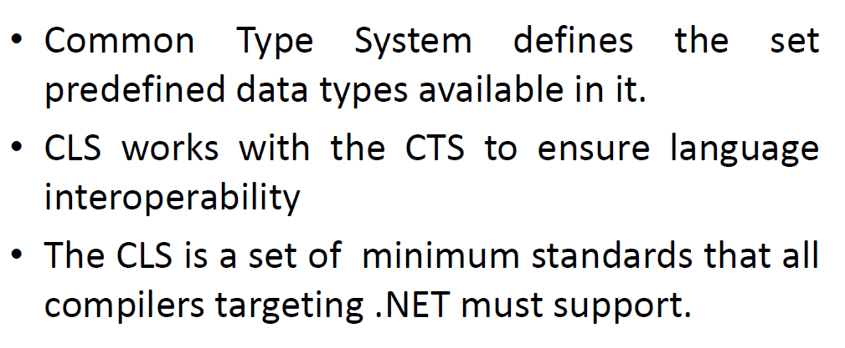
CLS and CTS

Slide 32
Assembly
An assembly is a file that is automatically generated by the compiler.
Dynamic Link Library or an executable file.
Generated only once, later assembly gets updated.
Background process of your application.
Two types of assemblies:
Single file
Multi file
Single file assembly: contains all the required information in a single package
IL
Metadata
Manifest

Slide 33
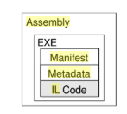
Assembly
An Assembly contains three files.

Slide 34
Assembly
IL: lowest-level human-readable programming language defined by the Common Language Infrastructure (CLI) specification and is used by the .NET Framework, which is similar to Java byte code.
Metadata:
Data about the data.
It yields the types of information available in that assembly, viz. classes, interfaces, enums, structs, namespaces, the name of each type, its visibility/scope, its base class, the interfaces it implemented, its methods and their scope, and each method’s parameters, type’s properties, and so on.
Manifest: contains information about the current version of the assembly, name, list of all files in the assembly and other related information.

Slide 35
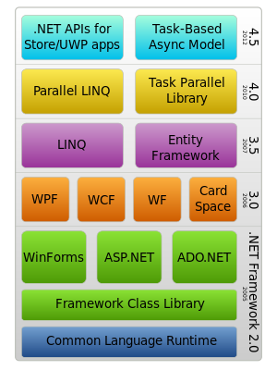
.Net Framework version 2.0 to 4.5

Slide 36
Visual Studio
Microsoft has introduced Visual Studio.NET, which is a tool (also called Integrated Development Environment) for developing .NET applications by using programming languages such as VB, C#, C++ and J#. etc.

Slide 37
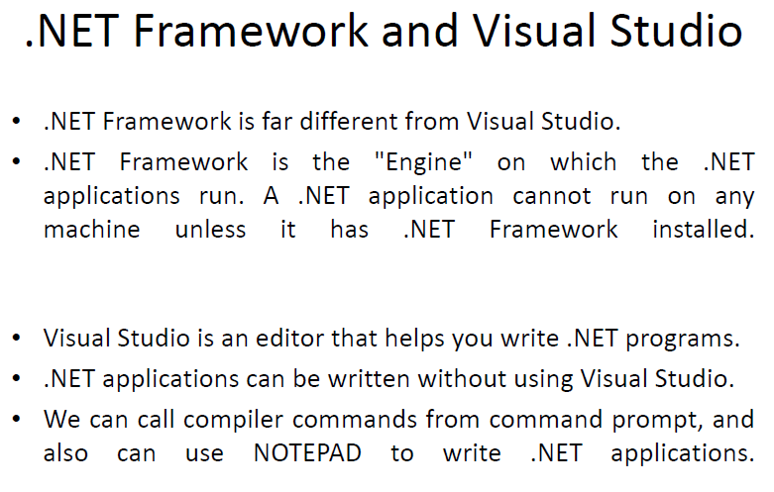

Slide 38
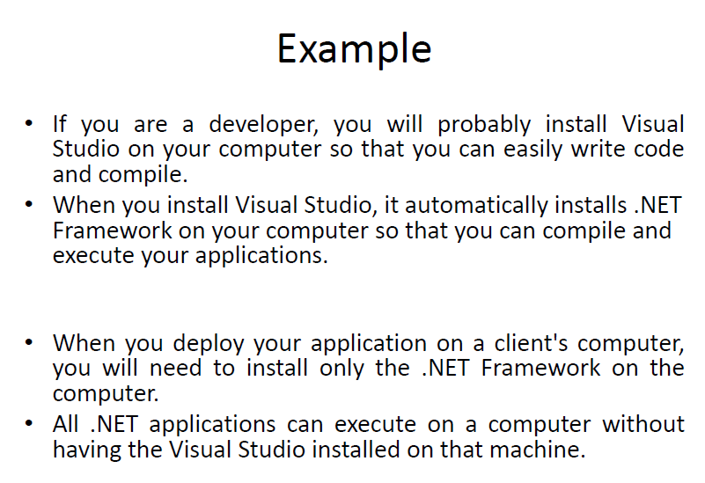

Slide 39
Exercise
1) What is ASP.NET?
2) Which are components of .NET Framework?
3) Discuss the components of .NET Framework.

Slide 40
Questions and Comments
???
Notes:
Faculty Notes:
Ask participants if they have any questions about the content covered in this presentation.

